Slide 1
Employee Data Analysis using Excel
STUDENT NAME : Fredrick raj. p. e
REGISTER NO : 122203666 (asunm1611d22cp013)
DEPARTMENT : B.Com Corporate Secretaryship
COLLEGE : Patrician College of Arts and Science

Slide 2
PROJECT TITLE
Employee Performance Analysis using Excel

Slide 3

AGENDA
Problem Statement
Project Overview
End Users
Our Solution and Proposition
Dataset Description
Modelling Approach
Results and Discussion
Conclusion

Slide 4

PROBLEM STATEMENT
The project aims to analyze employee data to gain insights into workforce demographics, performance trends, and employee satisfaction using Excel. The scope includes:
Scope:
Data Cleaning and Organization: Import and clean employee data (age, gender, department, salary, tenure) for analysis by deduplication and managing missing values.
Descriptive Analysis: Calculating basic statistics for salary distribution, average tenure, and departmental headcounts.
Trend and Performance Analysis: Using Excel functions and pivot tables to analyze trends and performance, including employee performance, turnover rates, and salary growth across departments.
Visualization:. Creating visual charts like bar graphs and pie charts for showing insights like departmental employee distribution or performance metrics.
Practical suggestions : Providing recommendations based on the analysis, such as improving retention strategies, optimizing workforce allocation, or addressing pay disparities.

Slide 5

PROJECT OVERVIEW
The goal of this project is to analyze employee data to gain insights into workforce characteristics, performance, and organizational trends. The analysis will help identify patterns related to employee demographics, performance metrics, and retention rates, supporting data-driven decision-making in HR management.
Project Objectives:
Understand Workforce Demographics: Analyze data on employee age, gender, department, and job role to identify trends in workforce composition.
Performance Evaluation: Study performance metrics, such as employee ratings, project completion rates, and KPIs, to evaluate overall productivity and identify high and low performers.
Identify Retention Issues: Analyze employee turnover rates, resignation reasons, and tenure to discover potential issues related to employee retention.
Improve HR Strategies: Use insights from the analysis to recommend strategies for improving employee satisfaction, retention, and performance.

Slide 6
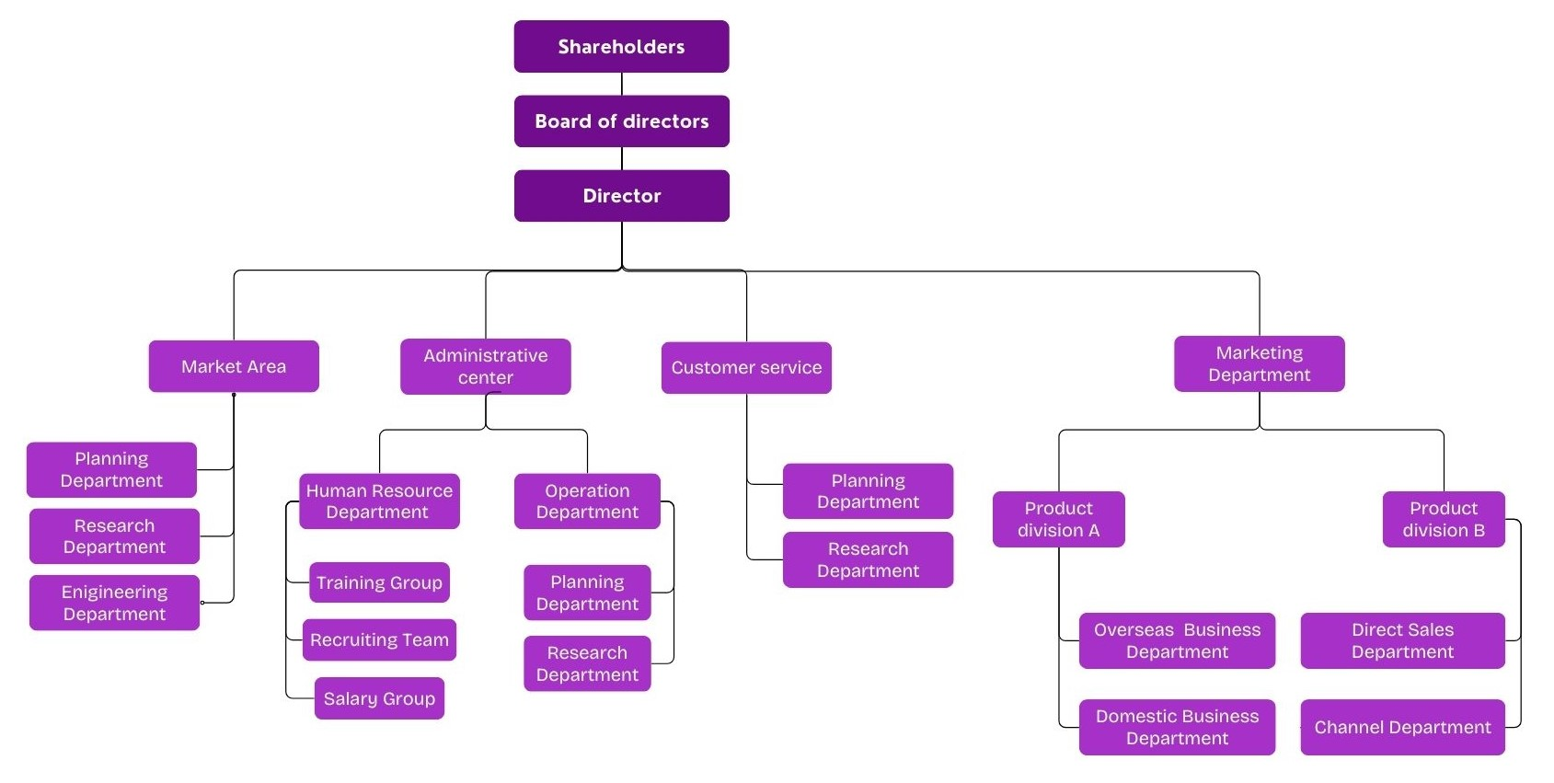

WHO ARE THE END USERS?

Slide 7

OUR SOLUTION AND ITS VALUE PROPOSITION
Conditional Formatting Missing
Filter Remove
Formula Performance
Pivot Chat Analysis Summary
Graph Data Visualization

Slide 8
Dataset Description
Employee–Kaggle
26–Features
Employee id–Numerical
Name–Text
Employee Types
Performance Level
Gender – Male, Female

Slide 9

THE "WOW" IN OUR SOLUTION
Formula:
Performance Level :
IFS(Z8>=5,"VERY HIGH",Z8>=4,"HIGH",Z8>=3,"MED",TRUE,"LOW")
3/21/2024 Annual Review
9

Slide 10
MODELLING
Data Collection
Employee id
First Name
Last Name
Business Unit
Employee States
Employee Types
Performance Level
High
Medium
Low
Summary
Data Collection
First Name
Last Name
Business Unit
Data cleaning
Performance Level
Formula
Missing Value
Employee States
Employee types
Feature Collection
Formula
Performance level
Data Cleaning
Missing Value
Performance level
10

Slide 11
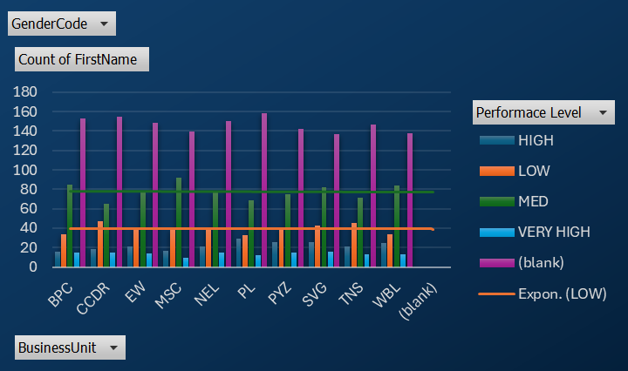
RESULTS
11

Slide 12
conclusion
The organization significantly enhanced how employee performance is evaluated and managed by developing an Employee Performance Analysis System using Excel. By consolidating diverse performance data into a structured and interactive Excel-based system, the organization will benefit from:
Centralized Data Management:
Efficiency: Bringing together quantitative metrics and qualitative feedback into a single Excel workbook simplifies data management and ensures consistency.
Accessibility: With all relevant data in one place, HR and management teams can more easily access and review performance information.
In-Depth Analysis:
Comprehensive Insights: The use of pivot tables, formulas, and charts allows for detailed analysis of employee performance, revealing trends, strengths, and areas for improvement.
Customizable Metrics: Users can tailor the system to include specific KPIs relevant to different roles, providing a more accurate assessment of individual and team performance.
Enhanced Visualization:
Clarity: Dashboards and visualizations present performance data in an easily interpretable format, helping stakeholders seize key insights and make informed decisions.
Interactive Tools: Features like slicers and filters enable users to dynamically explore data and focus on specific areas of interest.

